Slide 1



INTRODUCTION

Slide 2
Team Members
Introduction/Background: Siying Chen
Query 1: Jinhui Liu
Query 2: Aleksander Sekowski
Query 3: Adrian Marroquin
Query 4: Fereshteh Mamaghani

Slide 3
Dataset Details
Name: Pain Pills in the USA
Size: 12GB subset from 74GB
Source: https://www.kaggle.com/paultimothymooney/pain-pills-in-the-usa
Github: https://github.com/aleksUIX/CIS5200-team5

Slide 4

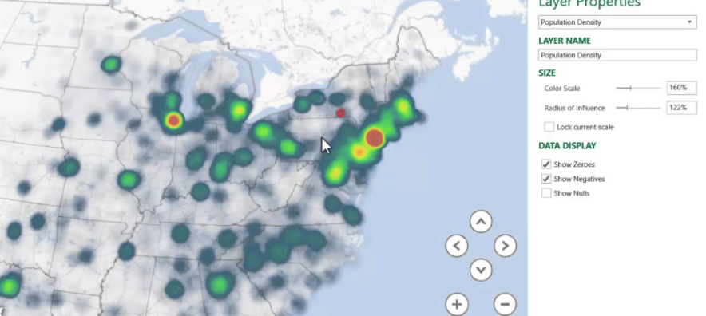


FLOWCHART OF DATA ANALYSIS
Download data from ARCOS
Use Spatial-Temporal diagrams, pie charts and other graphs to visualize the insights
Fix and Edit data details in Microsoft Excel
Uploaded the tsv file into HDFS
Create tables and relations using Hive and Pig
Output new file in ‘CSV’ or ‘TSV’ format to local hard drive

Slide 5
ARCOS
ARCOS Defined :
The Automation of Reports and Consolidated Orders System (ARCOS) is the automated system developed by DEA to monitor selected controlled substances.
Authority for ARCOS

Slide 6

Specifications
Cluster version: 20.3.3-20
Cluster number of nodes:3
Memory size: 180 GB RAM
Storage: 960 GB
CPU speed: 12 OCPUs

Slide 7

Market Share
Top 15 product

Slide 8

Why market share is important?
“Because market share is a key indicator of market competitiveness, it enables executives to judge total market growth or decline, identify key trends in consumer behavior and see their market potential and market opportunity.”
----Buxton
Notes:
“Market Share: The Most Important Metric for Business Success”, Buxton, https://www.buxtonco.com/blog/market-share-the-most-important-metric-for-business-success#:~:text=Because%20market%20share%20is%20a,market%20potential%20and%20market%20opportunity.

Slide 9
Create main table with original data
create external table if not exists painpilldata (
reporter_dea_no string, reporter_bus_act string, reporter_name string, reporter_addl_co_info string, reporter_address1 string, reporter_address2 string, reporter_city string, reporter_state string, reporter_zip string, reporter_county string, buyer_dea_no string, buyer_bus_act string, buyer_name string, buyer_addl_co_info string, buyer_address1 string, buyer_address2 string, buyer_city string, buyer_state string, buyer_zip string, buyer_county string, transaction_code string, drug_code string, ndc_no string, drug_name string, quantity int, unit int, action_indicator string, order_form_no string, correction_no string, strength string, transaction_date string, calc_base_wt_in_gm float, dosage_unit int, transaction_id string, product_name string, ingredient_name string, measure string, mme_conversion_factor string, combined_labeler_name string, revised_company_name string, reporter_family string, dos_str int )
ROW FORMAT DELIMITED FIELDS TERMINATED BY '\t'
STORED AS TEXTFILE LOCATION '/user/jliu2/Painpill'
TBLPROPERTIES ("skip.header.line.count"="1");

Slide 10
Create a table with Market Share by products
create table if not exists ms_product
row format delimited fields terminated by '\t'
stored as textfile location '/user/jliu2/Painpill/productms'
as
select product_name, sum(quantity) as quantity
from painpilldata group by product_name order by quantity desc;

Slide 11
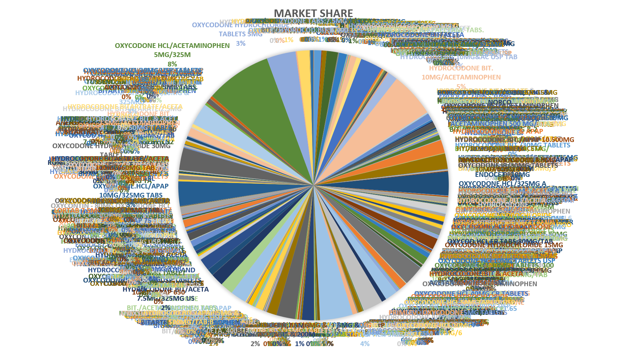
Notes:
967 rows So decide to narrow it down

Slide 12
Create a table with Market Share by Top15 Products
create table if not exists top15msp
row format delimited fields terminated by '\t'
stored as textfile location '/user/jliu2/Painpill/top15ms'
as
with top15 as (
select product_name, quantity from ms_product order by quantity desc limit 15)
select * from top15
union all
select "all other" as product_name, sum(quantity) as quantity
from ms_product
where product_name not in (select product_name from top15)
Notes:
Sub-table top15

Slide 13
Product Name | Quantity
OXYCODONE HCL/ACETAMINOPHEN 5MG/325M | 5482988
HYDROCODONE BIT. 10MG/ACETAMINOPHEN | 3726823
HYDROCODONE BIT/ACETAMINOPHEN 5MG/50 | 2714692
OXYCODONE HYDROCHLORIDE TABLETS 5MG | 2414112
OXYCODONE.HCL/APAP 10MG/325MG TABS | 2029077
ENDOCET - 10MG OXYCODONE.HCL/325MG A | 1974435
HYDROCODONE BIT/ACETA 7.5MG/500MG US | 1848954
OXYCODONE HYDROCHLORIDE 30MG TABLET | 1844479
HYDROCODONE.BIT./ACET.,10MG & 325MG/ | 1835527
OXYCODONE HCL/ACETAMINOPHEN 10MG/325 | 1685845
HYDROCODONE BIT/ACETA 10MG/325MG USP | 1659450
HYDROCODONE BIT 5MG/ACETAMINOPHEN 50 | 1556335
HYDROCODO.BIT/APAP 7.5MG/750MG USP T | 1337008
HYDROCODONE BIT/ACETA 10MG/500MG USP | 1271536
HYDROCODONE BIT. & APAP 5MG/500MG TA | 1087366
all other | 36913915
Notes:
3-D Clustered Bar without all other

Slide 14
Top 15 Painpill Product Market Share

Slide 15
Pain pills
Sales volume by state over time

Slide 16
Analysis: sales breakdown by state / year
Overdose death rates have quadrupled in the US since 1999, and 40% of all deaths involve prescription opioids*, which are primarily used for pain relief.
Although the legitimate supply of opioids may have decreased, overall consumption will remain unchanged if users decide to source them from illicit markets.
Source: https://www.bmj.com/company/newsroom/us-painkiller-restriction-linked-to-significant-increase-in-illicit-online-drug-trading/

Slide 17
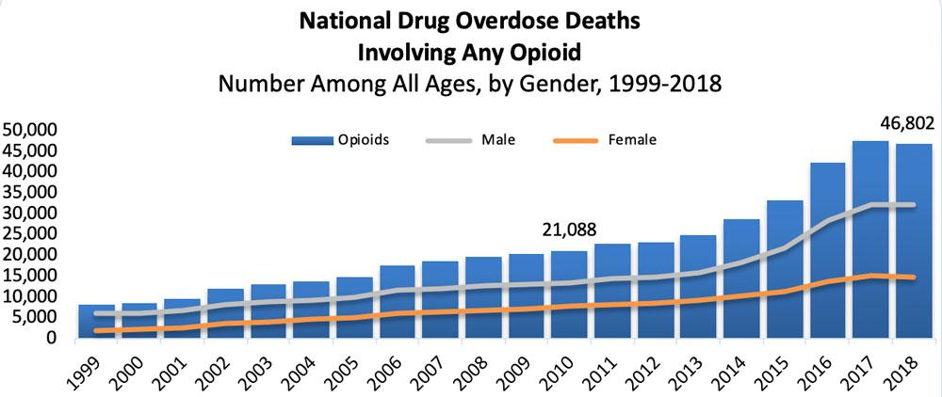
Goal: examine growth in prescription sales
Source: https://www.drugabuse.gov/drug-topics/trends-statistics/overdose-death-rates

Slide 18
Process
Filter out unnecessary columns from 40+ columns down to 4 in an intermedaite table drugs_year
Create a table grouped by year and reporter state
Download data as CSV and open in excel
Format time column, save as xlsx
Insert 3D map
Location: state, Height: quantity(sum/average), Category: drug name, Time: full date

Slide 19
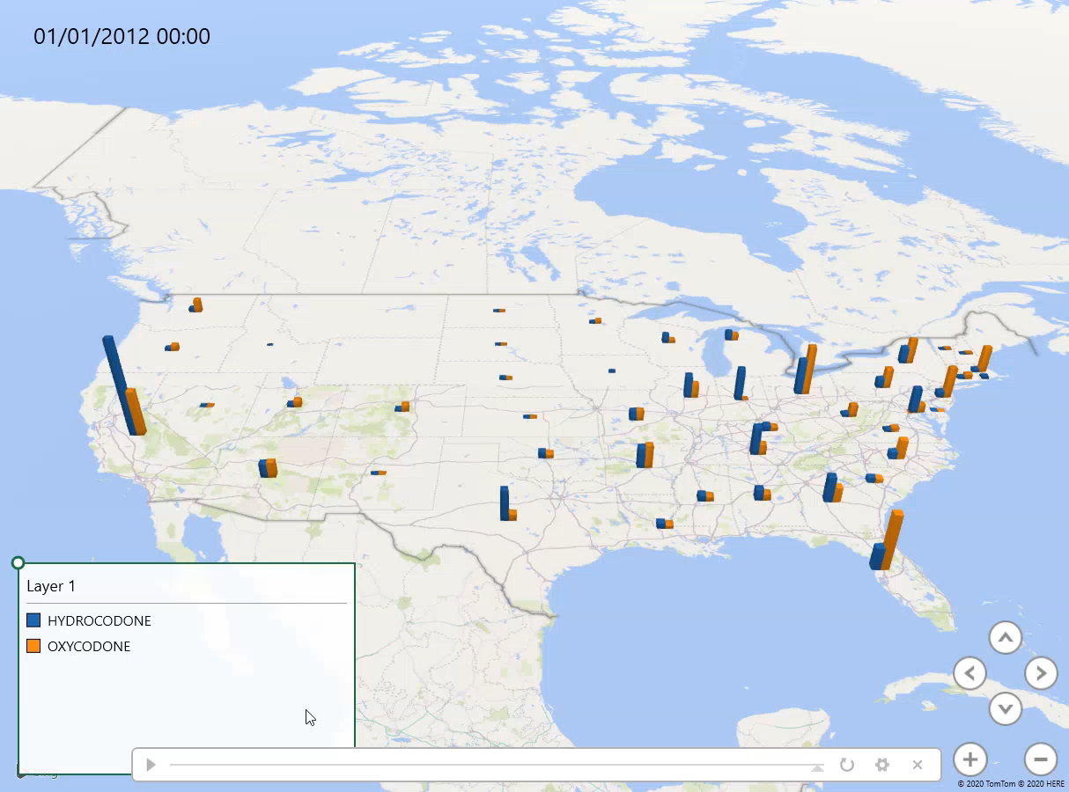
USA Trend over time – quantity (sum)

Slide 20
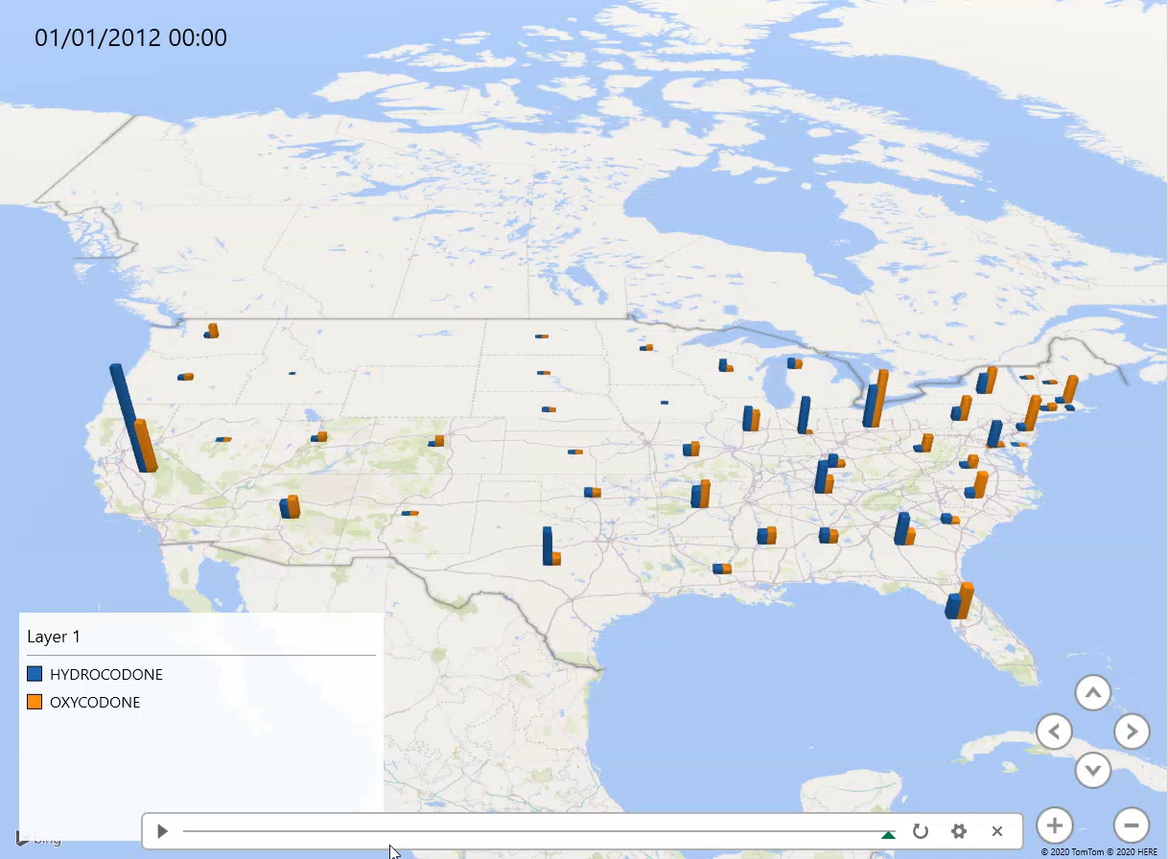
USA Trend over time – quantity (average)

Slide 21

Query 3 with Pig

Slide 22


What we know so far…
#1 used drug = Oxycodone
California one of the most affected states

Slide 23



Distribution By City
Where?

Slide 24
Code (1)
data = LOAD '/user/amarro15/practice/arcos_all_washpost1.tsv' AS (reporter_dea_no:chararray, reporter_bus_act:chararray, reporter_name:chararray, reporter_addl_co_info:chararray, reporter_address1:chararray, reporter_address2:chararray, reporter_city:chararray, reporter_state:chararray, reporter_zip:chararray, reporter_county:chararray, buyer_dea_no:chararray, buyer_bus_act:chararray, buyer_name:chararray, buyer_addl_co_info:chararray, order_form_no:chararray, correction_no:chararray, strength:int, transaction_date:chararray, calc_base_wt_in_gm:double, dosage_unit:int, transaction_id:chararray, product_name:chararray, ingredient_name:chararray, measure:chararray, ….and so on

Slide 25
Code (2)
drug_data = FILTER data BY drug_name == 'OXYCODONE';
california_subset = FILTER drug_data BY buyer_state == 'CA' AND reporter_bus_act == 'DISTRIBUTOR';
grouped = GROUP california_subset BY reporter_city;
totals = FOREACH grouped GENERATE group, SUM(california_subset.quantity) AS city_count;

Slide 26
Code (3)
sorted = ORDER totals BY city_count DESC;
top_ten = LIMIT sorted 100;
DUMP top_ten;
STORE top_ten INTO 'output/top_ten' USING PigStorage(',');

Slide 27
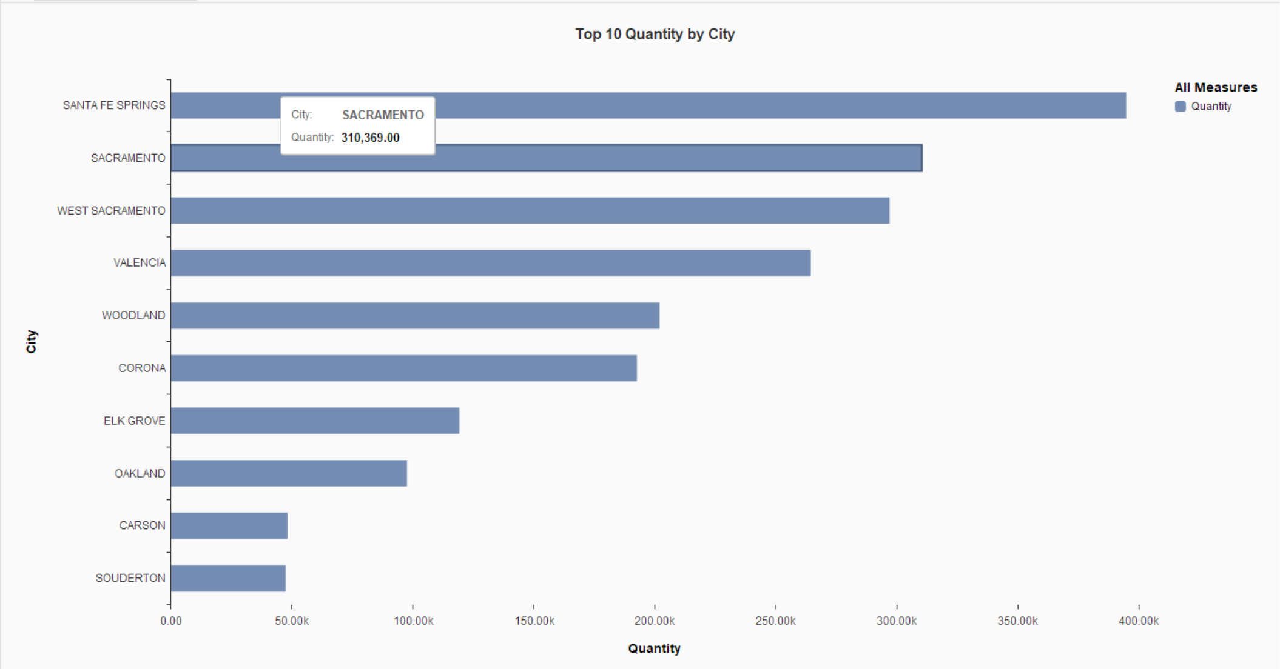
California’s Top Cities with Highest Distribution

Slide 28
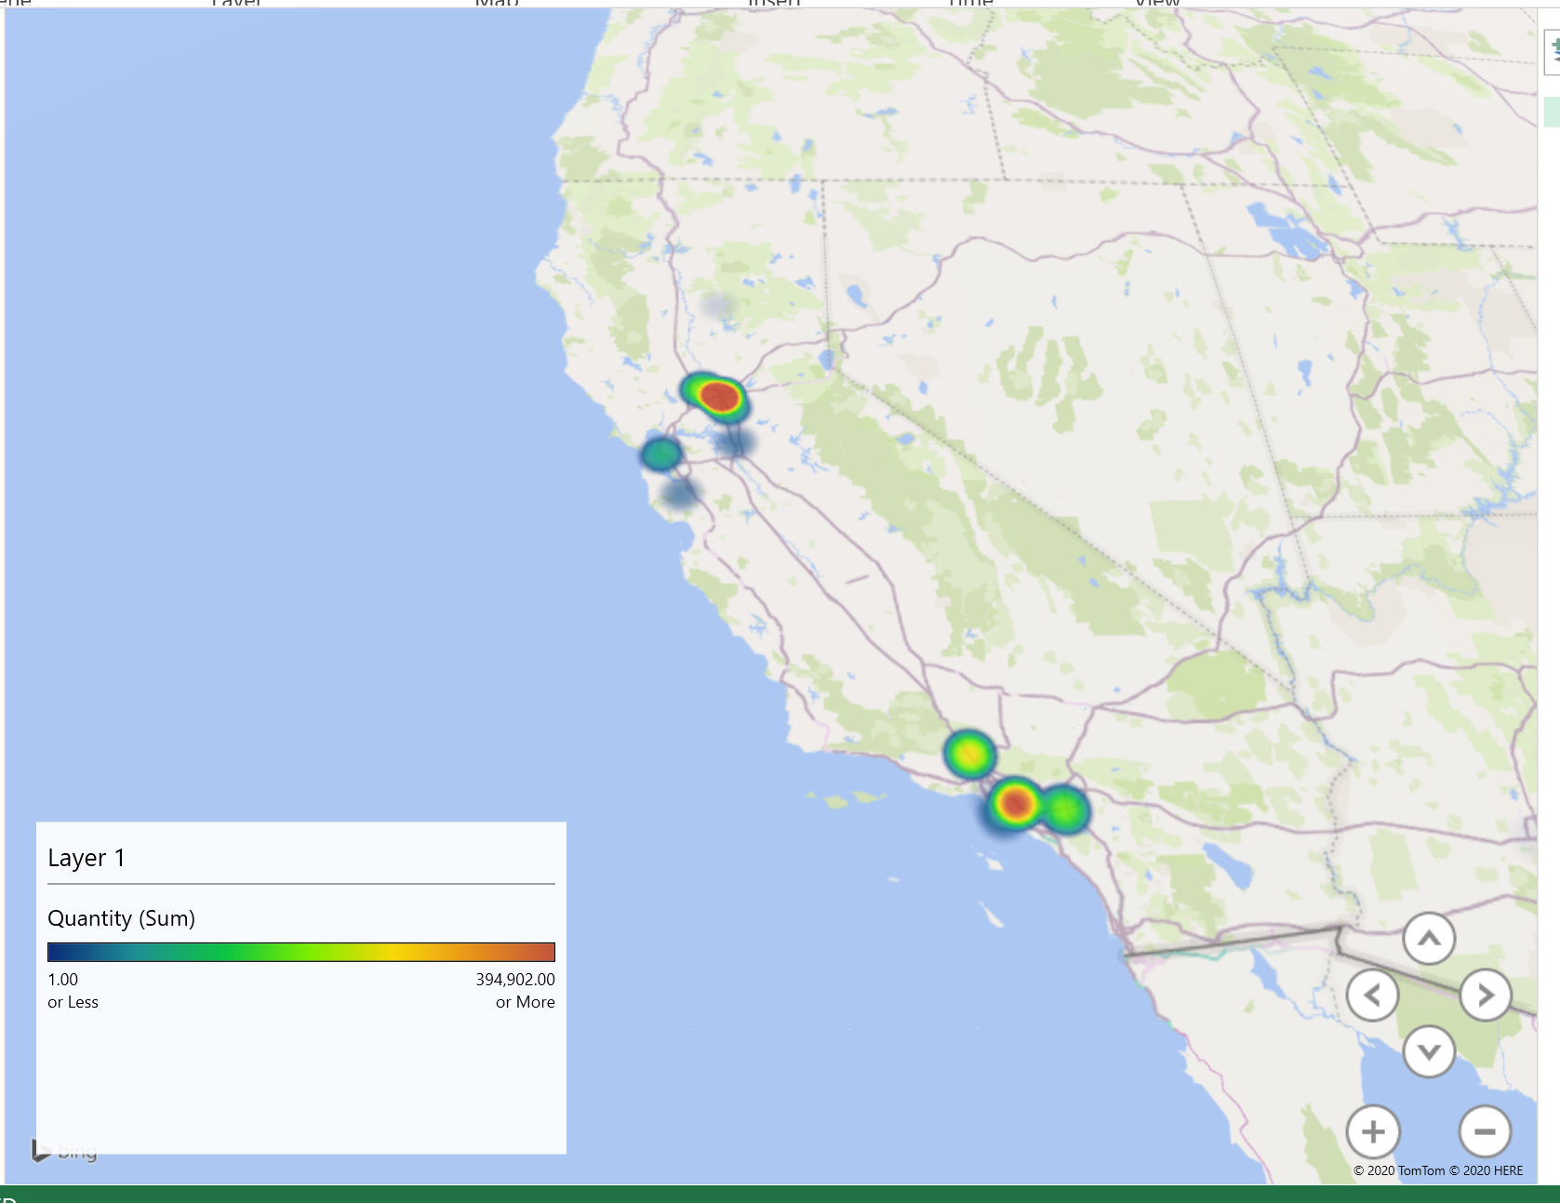
Result (Map)

Slide 29
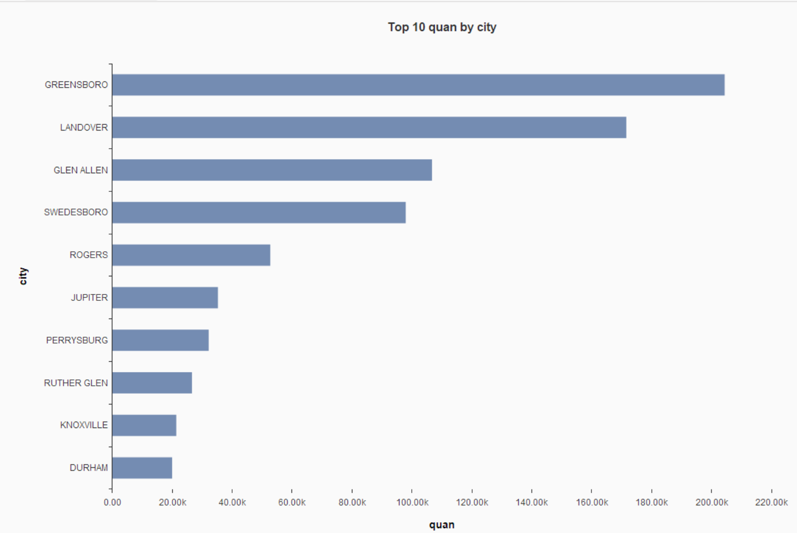
Virginia’s Top Cities with Highest Distribution

Slide 30
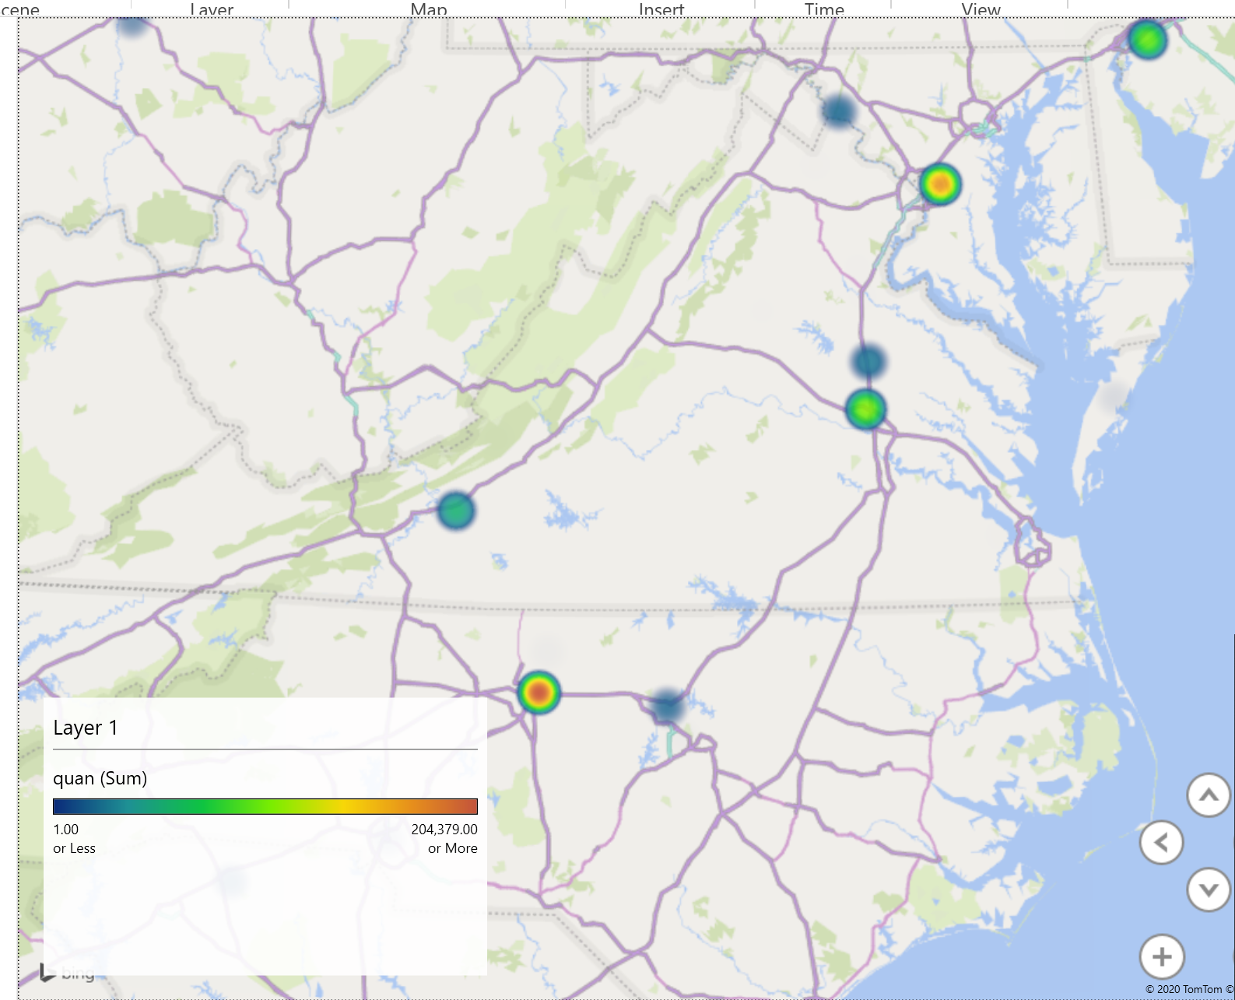
Top Distributed Cities (Virginia)

Slide 31
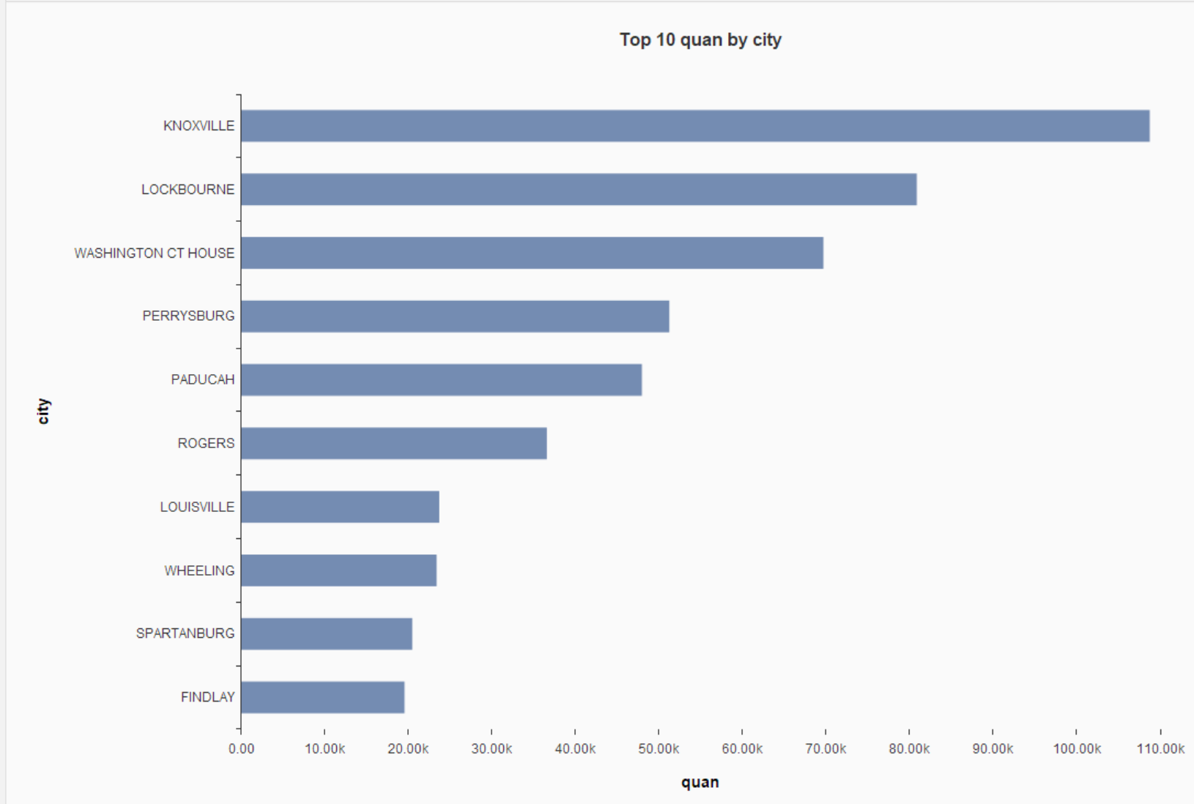
Kentucky’s Top Cities with highest Distribution

Slide 32
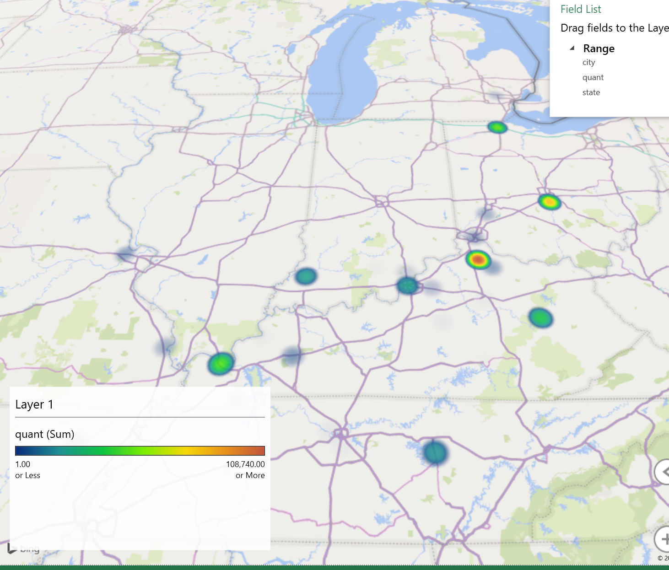
Top Distributed Cities (Kentucky)

Slide 33

Pain pills in the USA From The Washington Post | Kaggle
ETL for ARCOS section of buyers of pain pills’ Components and their transactions in the USA
(Query4)

Slide 34

Objective
Analysis of distribution of every buyer of controlled drugs for the top N buyers
Buyers Locations
Date of Top N transaction
Amount of Top N transaction

Slide 35
Preparing the data for the Queries
The Original data is a tsv file with 42 columns
13 columns are interesting for the queries
The main table is created in hive that include everything in the data
CREATE TABLE if not exists pain_pills (
REPORTER_DEA_NO STRING , | BUYER_ADDL_CO_INFO STRING , | ORDER_FORM_NO INT , | ROW FORMAT DELIMITED
REPORTER_BUS_ACT STRING , | BUYER_ADDRESS1 STRING , | CORRECTION_NO INT , | FIELDS TERMINATED BY '\t'
REPORTER_NAME STRING , | BUYER_ADDRESS2 STRING , | STRENGTH INT , | STORED AS TEXTFILE
REPORTER_ADDL_CO_INFO STRING , | BUYER_CITY STRING , | TRANSACTION_DATE STRING , | LOCATION "/user/fmamagh2/Group5"
REPORTER_ADDRESS1 STRING , | BUYER_STATE STRING , | CALC_BASE_WT_IN_GM FLOAT , | TBLPROPERTIES ('skip.header.line.count'='1');
REPORTER_ADDRESS2 STRING , | BUYER_ZIP STRING , | DOSAGE_UNIT INT ,
REPORTER_CITY STRING , | BUYER_COUNTY STRING , | TRANSACTION_ID INT ,
REPORTER_STATE STRING , | TRANSACTION_CODE STRING , | Product_Name STRING ,
REPORTER_ZIP STRING , | DRUG_CODE INT , | Ingredient_Name STRING ,
REPORTER_COUNTY STRING , | NDC_NO BIGINT , | Measure STRING ,
BUYER_DEA_NO STRING , | DRUG_NAME STRING , | MME_Conversion_Factor INT ,
BUYER_BUS_ACT STRING , | QUANTITY INT , | Combined_Labeler_Name STRING ,
BUYER_NAME STRING , | UNIT INT , | Revised_Company_Name STRING ,
 | ACTION_INDICATOR INT , | Reporter_family STRING ,
 |  | dos_str INT)

Slide 36

Connecting to pig interactive mode using Grunt Shell and sharing data between Hive and Pig by HCatalog
pig –useHCatalog
Load all data into pig based on hive database
Extract the interesting fields for ETL Processing
pig -useHCatalog
data = LOAD 'fmamagh2.pain_pills' using org.apache.hive.hcatalog.pig.HCatLoader();
Buyers = foreach data generate buyer_dea_no, buyer_bus_act,
buyer_name, buyer_address1,
buyer_address2, buyer_city,
buyer_state, buyer_zip, buyer_county,
drug_code, drug_name, quantity,
transaction_date;

Slide 37

Filtering Data Based on Types of Drugs
Two categories of drugs
Split the Buyers based on their drug category purchase
c = foreach Buyers generate drug_code, drug_name;
Drugname = DISTINCT c;
dump Drugname;
(9143,OXYCODONE)
(,DRUG_NAME)
(9193,HYDROCODONE)
SPLIT Buyers INTO B_OXY IF drug_name == 'OXYCODONE', B_HYDRO IF drug_name == 'HYDROCODONE' ;

Slide 38
Extracting the top 100 Buyers of Oxycodone
bo1 = foreach B_OXY generate buyer_dea_no, drug_name, quantity;
bo2 = group bo1 by buyer_dea_no;
describe bo2;
bo_total = foreach bo2 generate group, SUM(bo1.quantity) As total;
bo_sort = ORDER bo_total BY total desc;
bo100 = limit bo_sort 100;
oxy_total1 = JOIN bo100 BY group, boName BY buyer_dea_no;
oxy_total2 = foreach oxy_total1 generate boName::buyer_dea_no AS buyer_dea_no , boName::buyer_name AS buyer_name , boName::drug_name AS drug_name , bo100::total AS total;
oxy_total100 = ORDER oxy_total2 BY total DESC;
STORE oxy_total100 INTO 'Buyers/oxytotal';

Slide 39
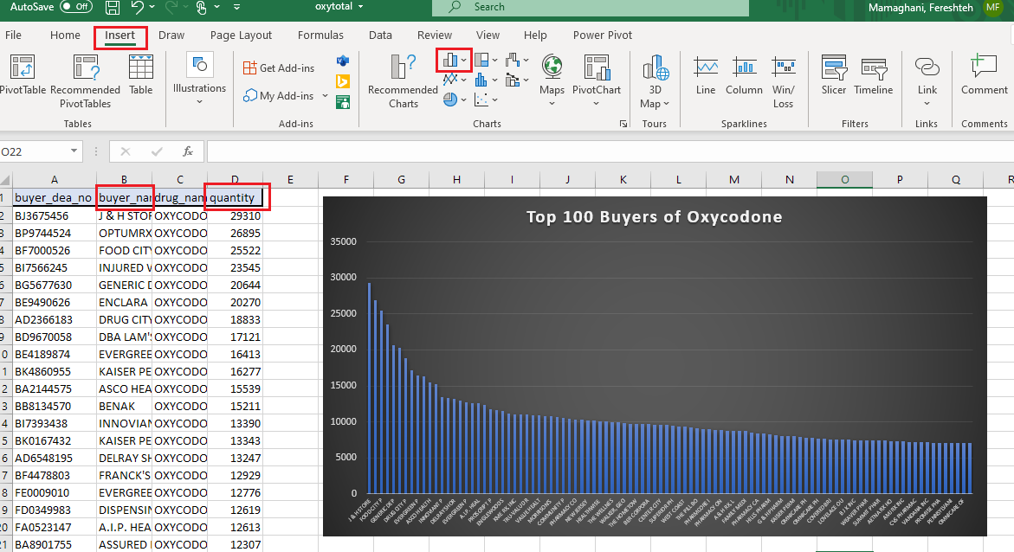
Top 100 Buyers of Oxycodone

Slide 40
List of Top 2 purchases per each Oxycodone buyer in Top 100
Buyer_oxy1 = group B_OXY BY buyer_dea_no;
Buyer_oxy2 = foreach Buyer_oxy1{
sorted = ORDER B_OXY BY quantity DESC;
high_qty = limit sorted 2;
generate group, FLATTEN(high_qty);};
Buyer_oxy3 = JOIN oxy_total100 BY buyer_dea_no , Buyer_oxy2 BY group;

Slide 41
List of Top 2 purchases per each Oxycodone buyer in Top 100(Cont’d)
Prepare the date format for 3D map in excel
Buyers_Detail1 = foreach Buyer_oxy3 generate oxy_total100::buyer_dea_no AS buyer_dea_no, Buyer_oxy2::high_qty::buyer_bus_act AS buyer_bus_act, oxy_total100::buyer_name AS buyer_name, …, Buyer_oxy2::high_qty::quantity AS quantity, Buyer_oxy2::high_qty::transaction_date AS Date;
Buyers_Detail = foreach Buyers_Detail1 generate buyer_dea_no, buyer_bus_act, buyer_name, buyer_name_dtl, buyer_address1, buyer_address2, buyer_city, buyer_state, buyer_zip, buyer_county, drug_name, quantity, CONCAT(SUBSTRING(Date,0,2),'/',SUBSTRING(Date,2,4),'/',SUBSTRING(Date,4,9)) AS Date;

Slide 42
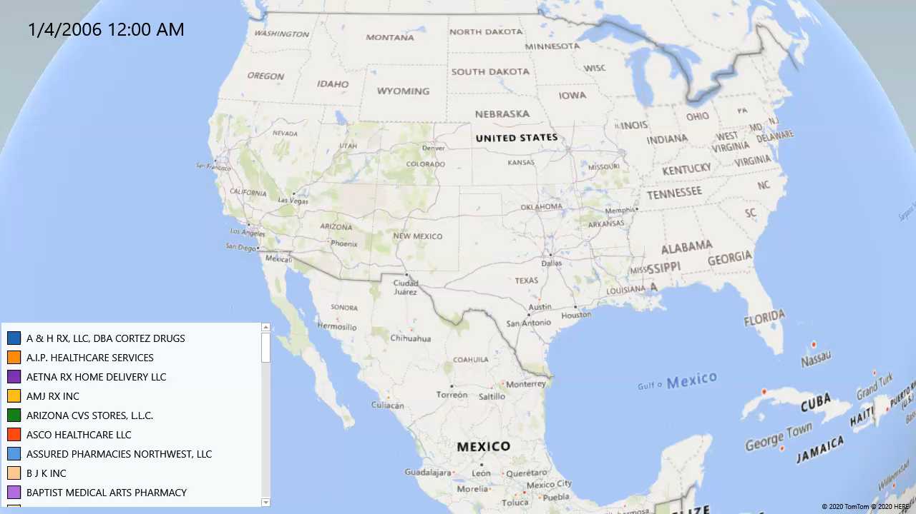
Distribution of Top 100 Oxycodone Buyers, accumulated by amount of Top 2 purchases

Slide 43
Thank you Q&A

